Slide 1
AI-Driven CI/CD with Python Automations

Slide 2
Overview of AI-Driven CI/CD with Python
1
2
3
4
AI-Powered Automation​
AI models automate pipeline stages, enabling smarter, adaptive DevOps processes.​
Python-Based Pipeline​
Python libraries replace traditional CI/CD tools, ensuring flexibility and control.​
Comprehensive Lifecycle Support
Python supports version control, testing, deployment, and monitoring in one language.​
Intelligent Decision-Making
​ AI predicts test failures, optimizes resources, and detects anomalies in real-time

Slide 3
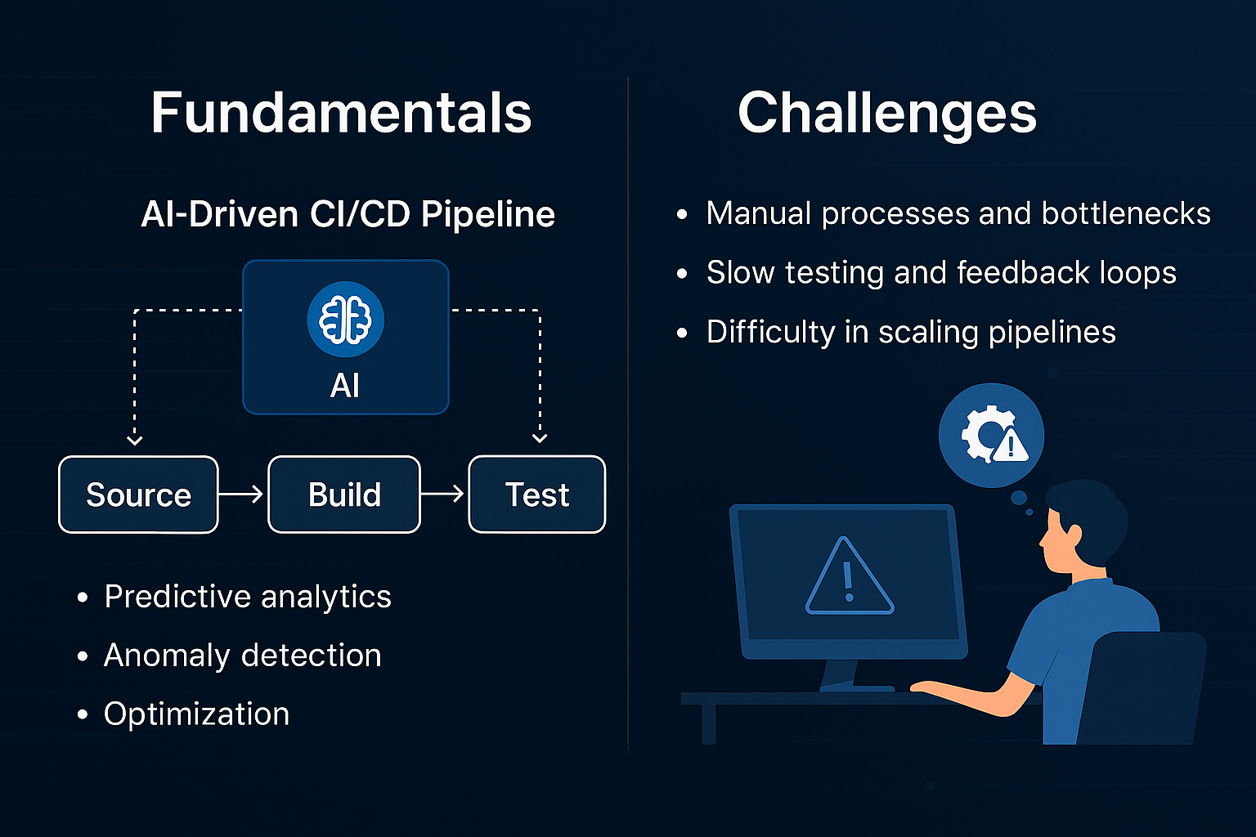

Slide 4

Why Python for CI/CD?​
01
Simplicity and Readability
02
Full Automation Control
03
AI Integration Capability
04
Strong Community Support

Slide 5
Traditional CI/CD Challenges
1
Tool Dependency Limits
Traditional CI/CD systems depend heavily on specific tools, reducing flexibility and adaptability.​
2
Complex Configurations
Configurations in traditional systems are complicated, creating barriers to customization and advanced feature integration.​
3
Slow Feedback and Maintenance​
Slow feedback loops and high maintenance overhead hinder efficient development and deployment processes.​
Lack of Intelligent Automation​
4
Absence of AI-driven decision-making leads to inefficiencies like unnecessary tests and unstable builds.​

Slide 6
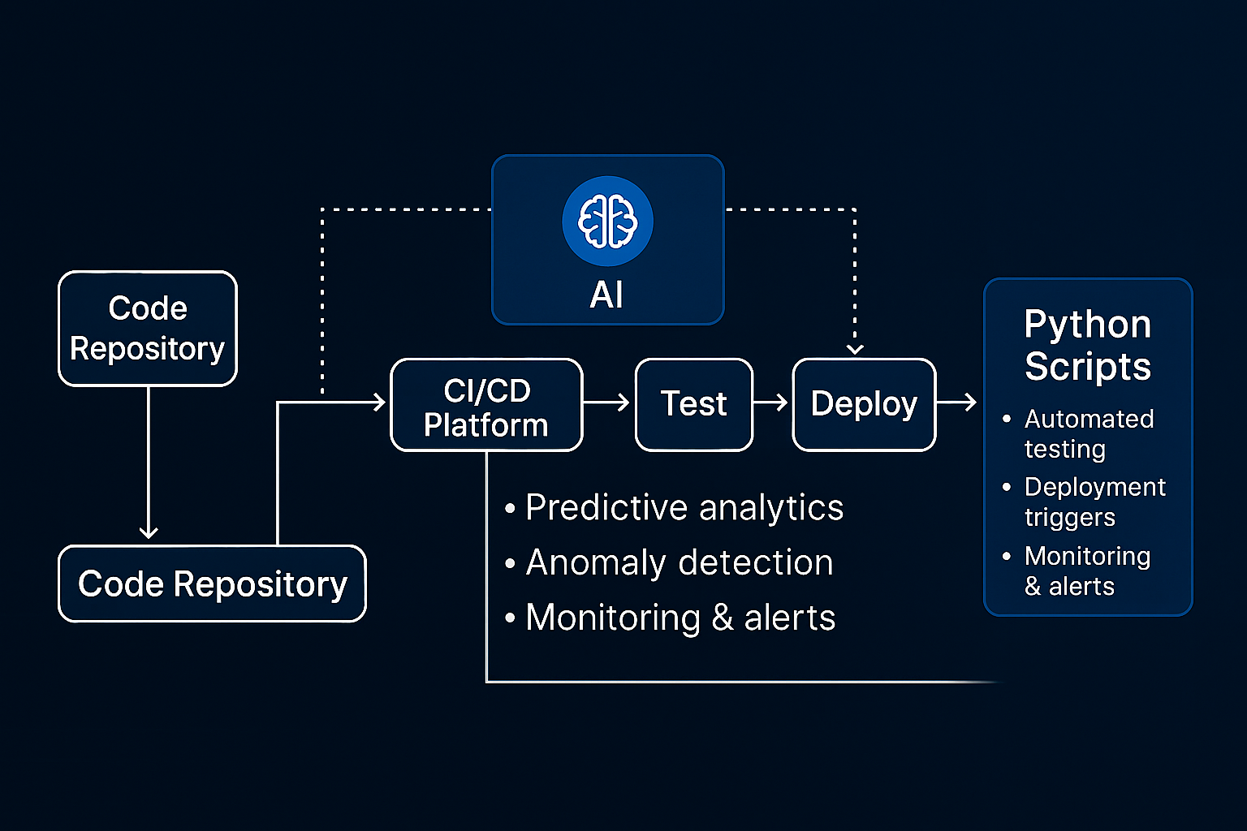
Pipeline Architecture and Components

Slide 7

Version Control Integration​
GitPython
Automation​
01
Advanced Workflow Support
Real-Time Pipeline Response​
02
04
Consistency and Error Reduction
03

Slide 8
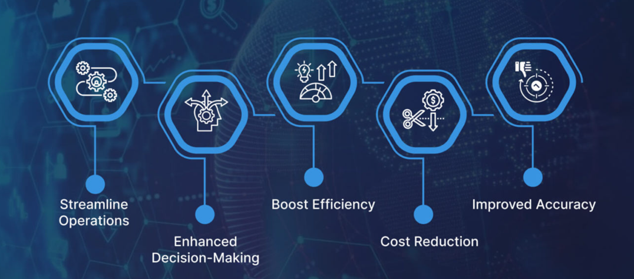
Automation and AI Integration
In this slide, we look at how Python handles automation and how AI adds intelligence to it. Python scripts can automate everything from testing to deployment.
AI models can analyze past data to predict failures, choose the most relevant tests, and even decide whether to deploy or rollback.
01
Together, automation and AI make CI/CD pipelines faster, more reliable, and less dependent on manual intervention.
02
03

Slide 9
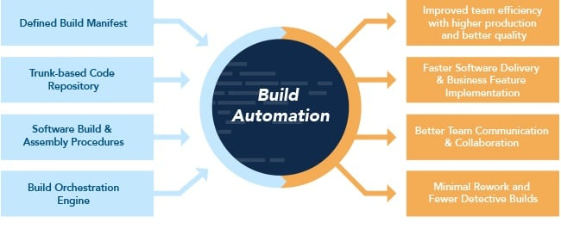
Build Automation
Python Build Tools​
Invoke and fabric libraries automate build tasks in Python-based pipelines.​
Task Automation​
Automating compiling, environment setup, and dependency management reduces manual work.​
Customizable Build Scripts​
Build scripts can be tailored to fit diverse project requirements and workflows.​
AI Integration​
AI predicts build outcomes and suggests optimizations to enhance reliability.​

Slide 10
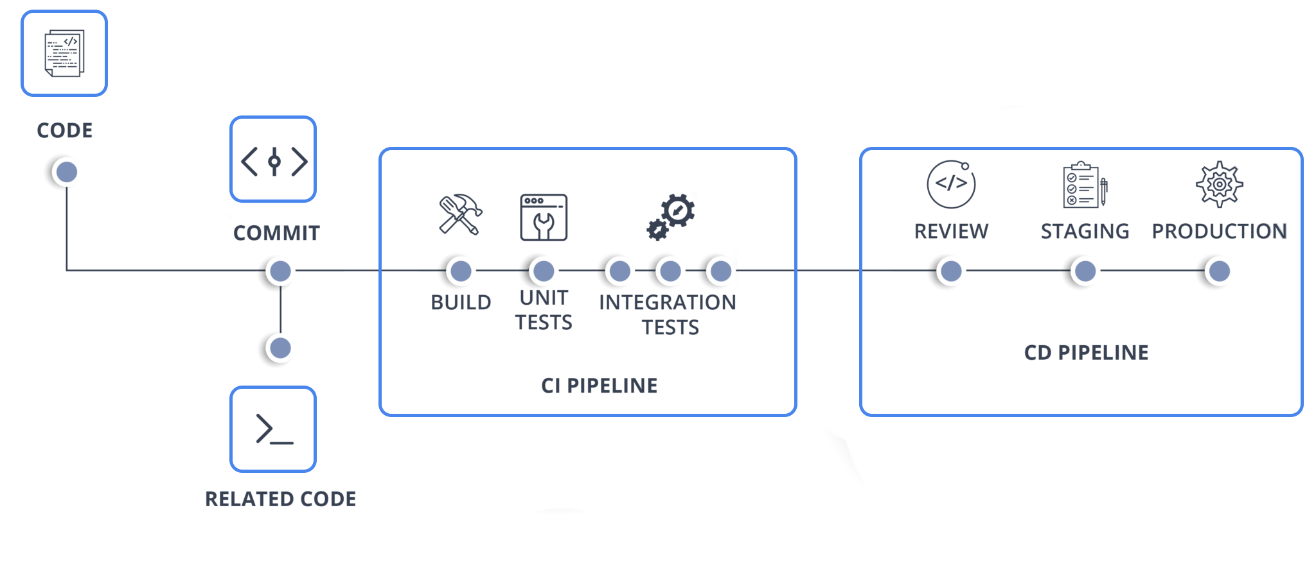
Deployment
Automation with Python Libraries​
AI Predictive Analysis​
Resource Optimization​
Reduced Downtime and Risks​
Monitoring

Slide 11
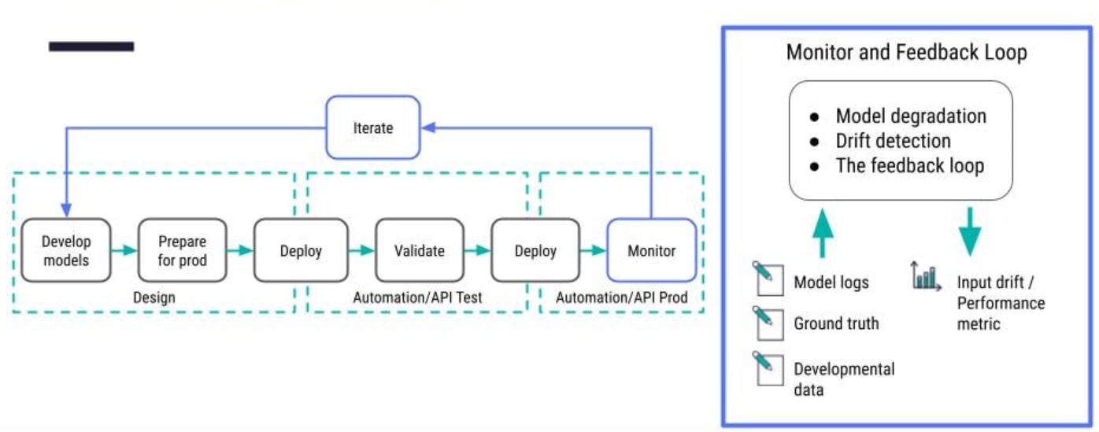
Monitoring and Feedback​
System Metrics Collection​
AI Anomaly Detection
Predictive Optimization​
Adaptive Feedback Integration

Slide 12
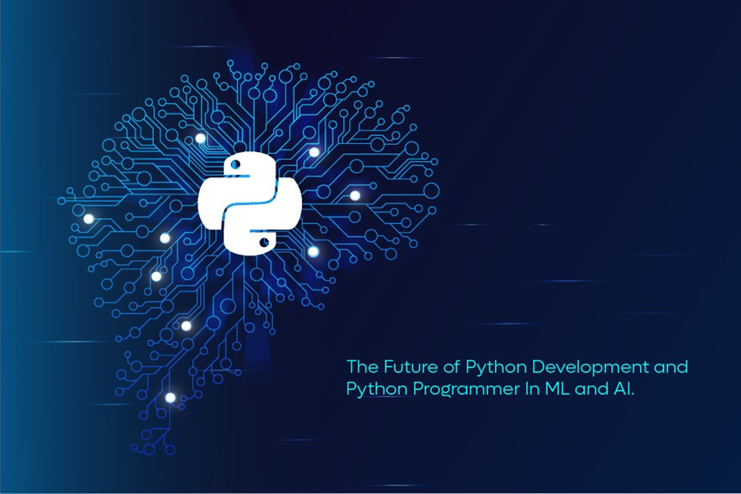
Summary and Benefits
Comprehensive Python Libraries​
Utilizes libraries like GitPython, pytest, scikit-learn, TensorFlow, and boto3 for complete pipeline tasks.​
Eliminates External Dependencies​
Pipeline operates independently without relying on external tools, ensuring greater control and flexibility.​
Customizable & Intelligent Automation​
Allows highly customizable workflows integrated with intelligent automation for efficient CI/CD processes.​
Cost-Effective & Scalable​
Leverages Python and AI to build scalable, efficient CI/CD pipelines aligned with modern DevOps best practices.​

Slide 13
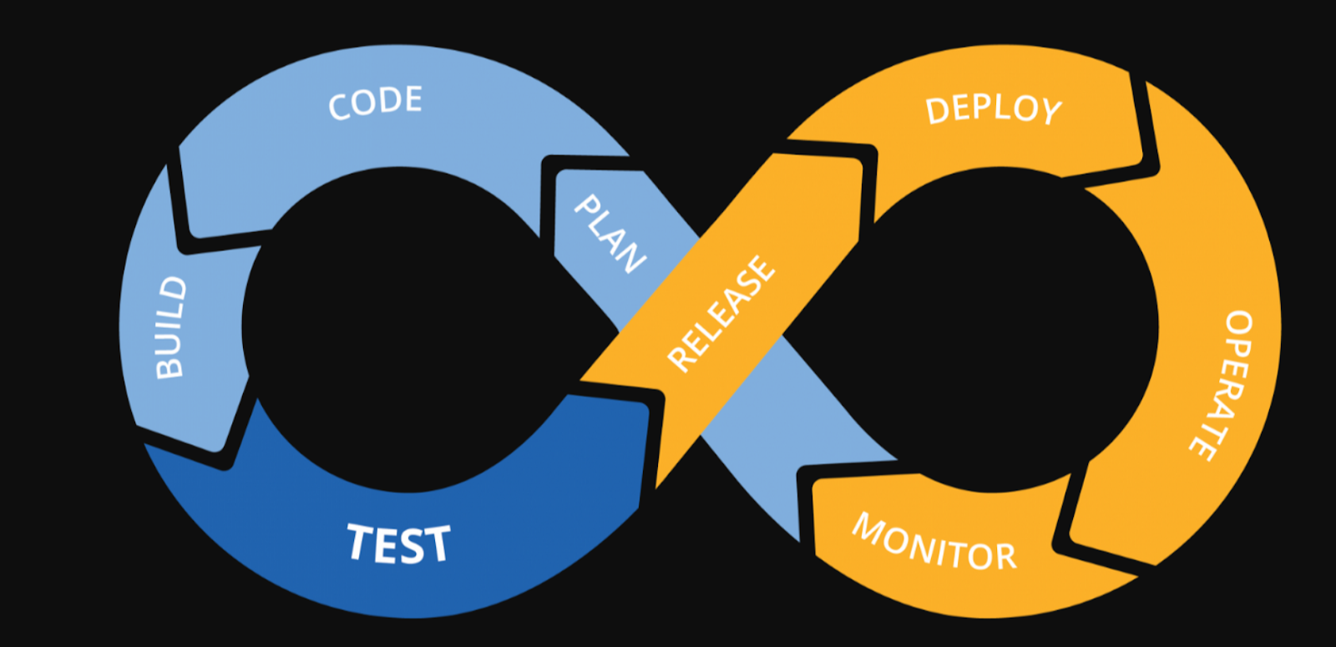
Conclusion
AI-Driven Pipeline Benefits​:
Using AI in CI/CD pipelines enhances flexibility, intelligence, and operational efficiency.​
Python-Based Automation​:
Python enables full automation of software delivery without external dependencies.​
Empowering Teams:​
This solution empowers teams to maintain control and innovate within their delivery workflow.​

